Slide 1
24. Make a Java Program Distributable
Using Gradle

Slide 2
gradle distZip
Packaging your program based on command line interface (CLI)
Scripts for executing your programs in cmd or terminals in Mac and Linux are automatically generated
Related external libraries are automatically packaged together
All files are zipped so we can easily distribute our package to the public. So you can upload your package in your Github or homepage
e.g.
https://github.com/lifove/CLAMI/releases

Slide 3
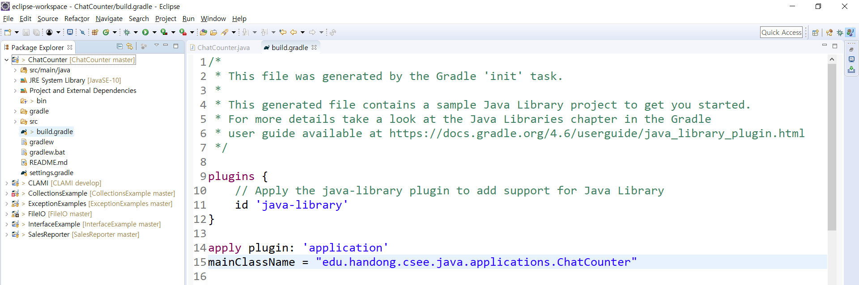
Open 'build.gradle' in Eclipse
(1) Add "apply plugin: 'application' in your build.gradle file. This will allow to run 'gradle distZip' on your cmd or terminals.
(2) Set mainClassName. It must be fully qualified Class name that contains the main method. (e.g., package name for the class + class name)

Slide 4
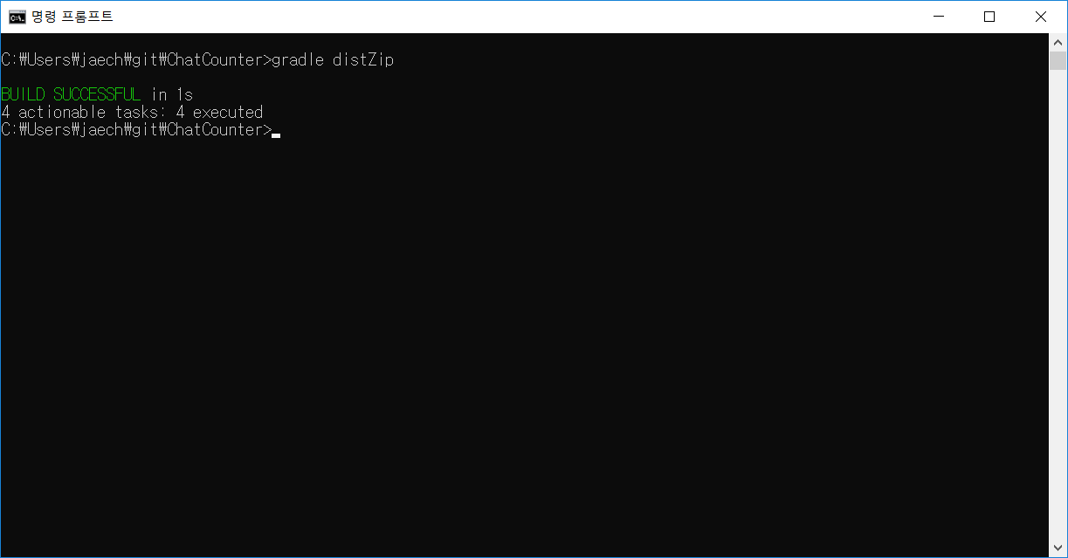
Run 'gradle distZip' in your project root.

Slide 5
Then, you will have a distributable package!
In your project root
cd build
cd distributions
Then, you will see [YOUR_PROJECTNAME].zip
This zip is your final package
Unzip the file and then you can see 'bin' and 'lib' directories under the directory with your project name.
The 'bin' directory have scripts to run program
'[ProjectName].bat' for Windows
'./[ProjectName]' for Mac or Linux
The 'lib' directory contains all external libraries to run your program.

